Slide 1


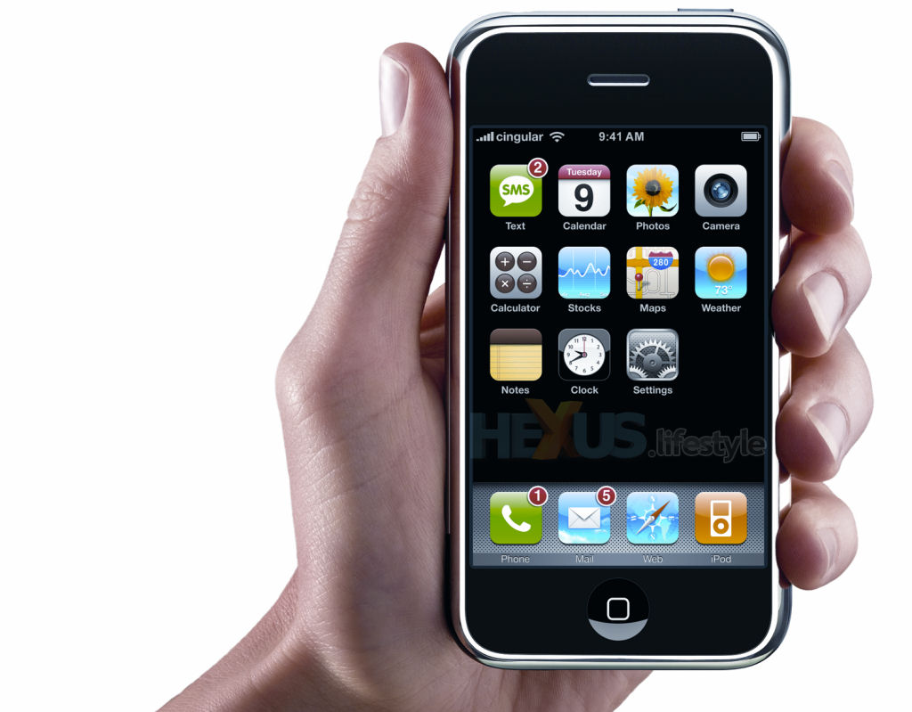
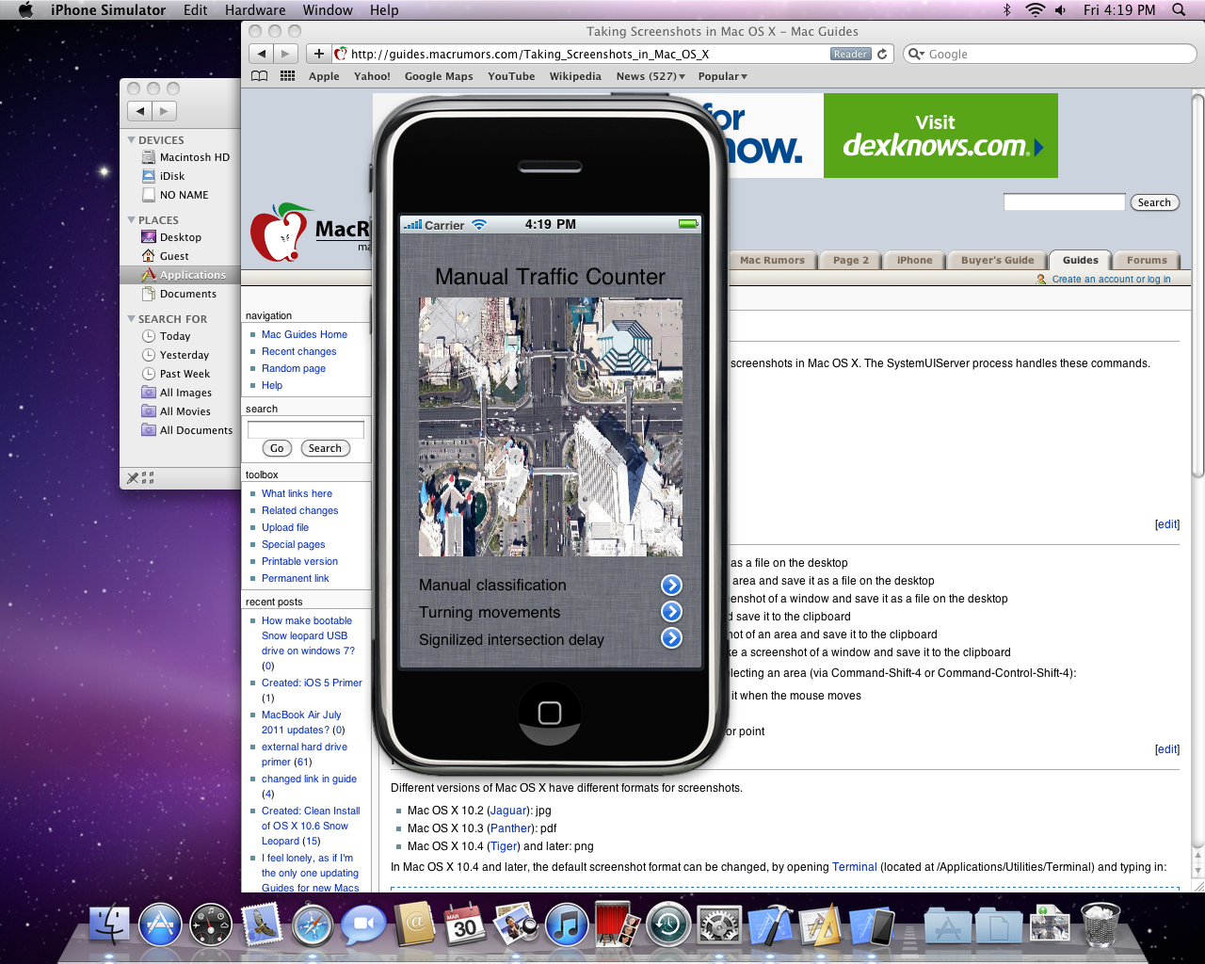
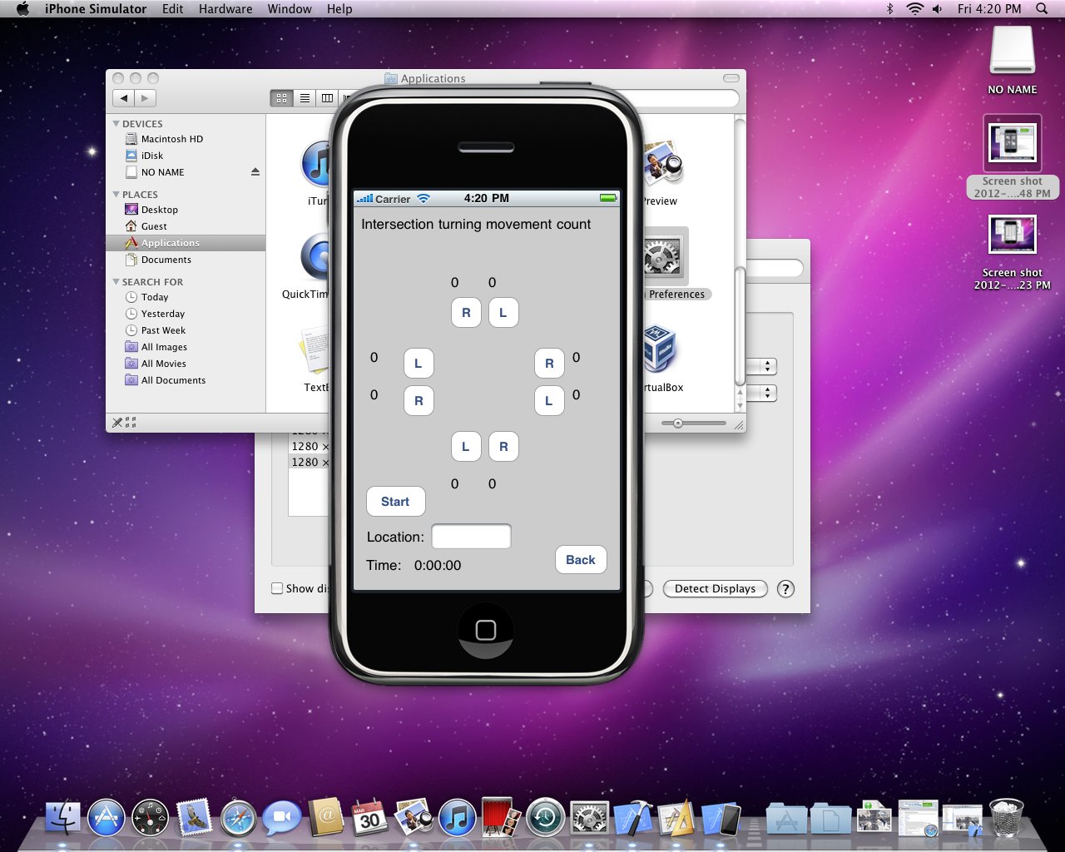
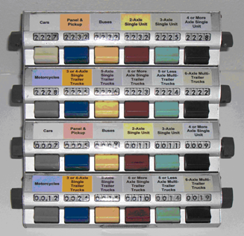
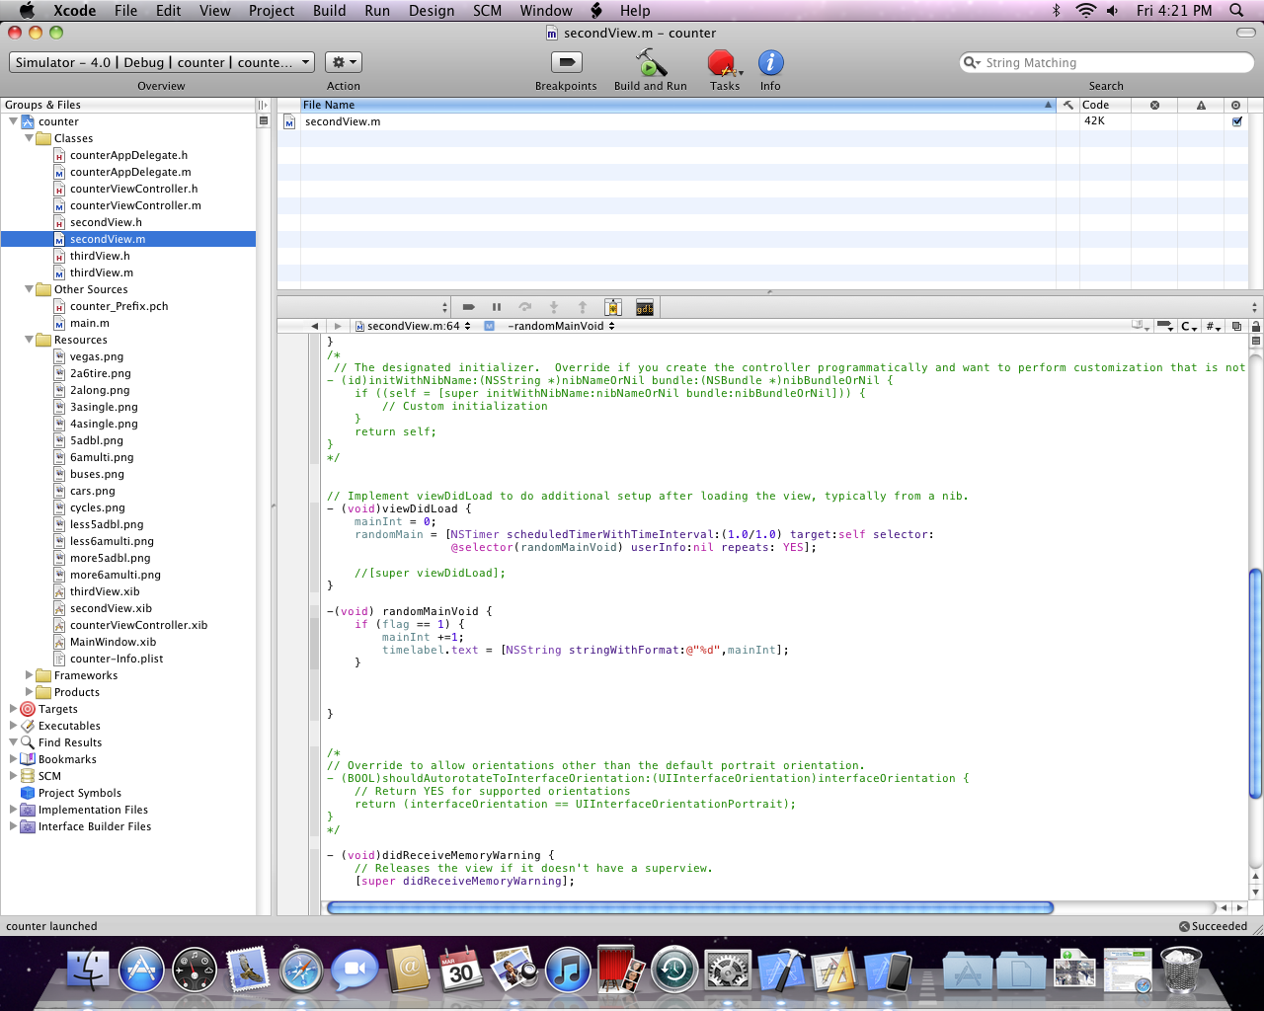
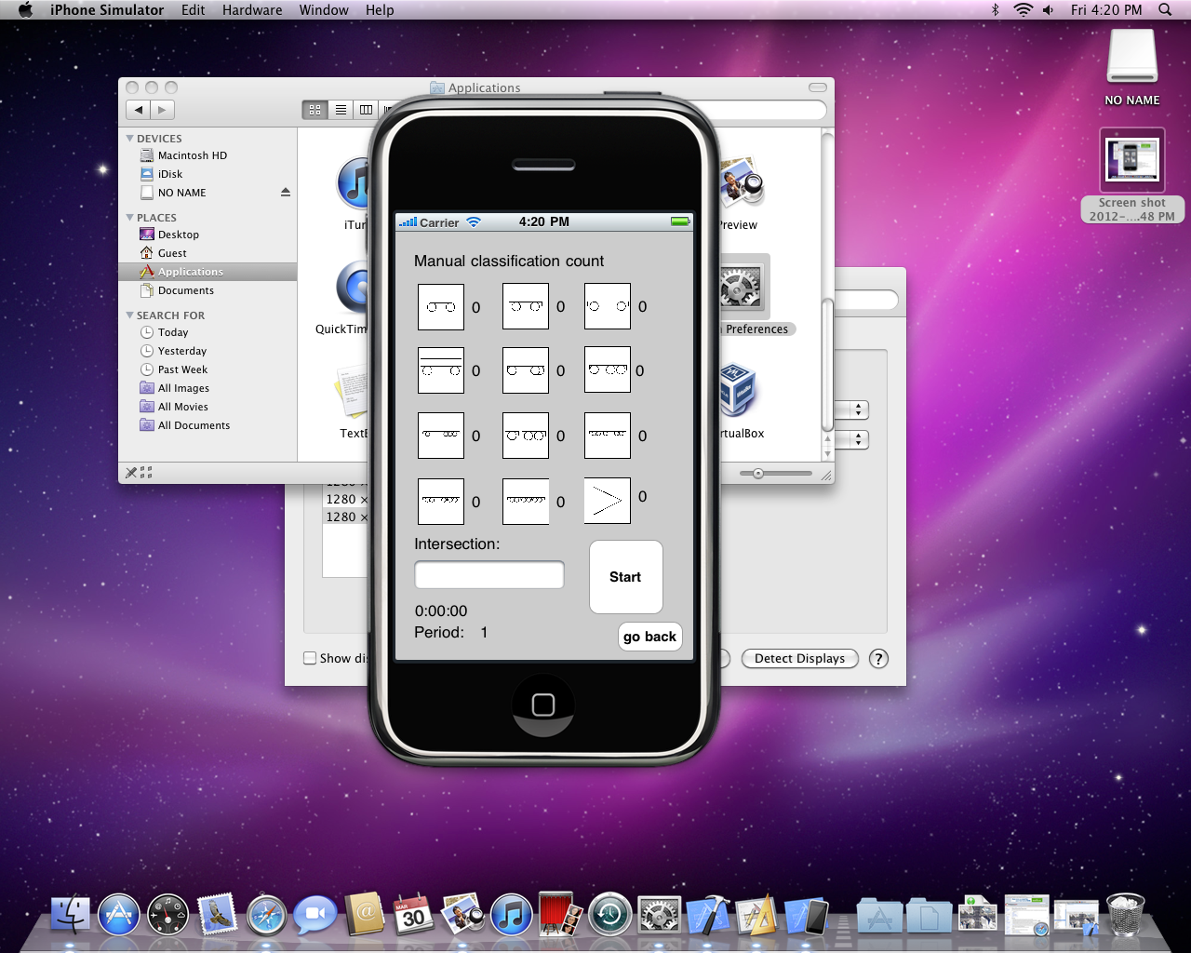
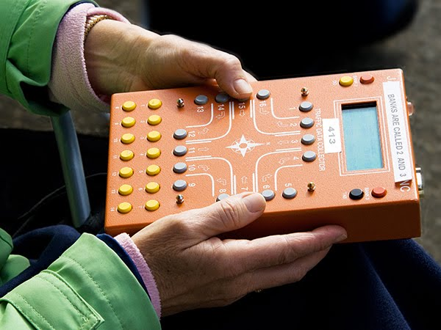
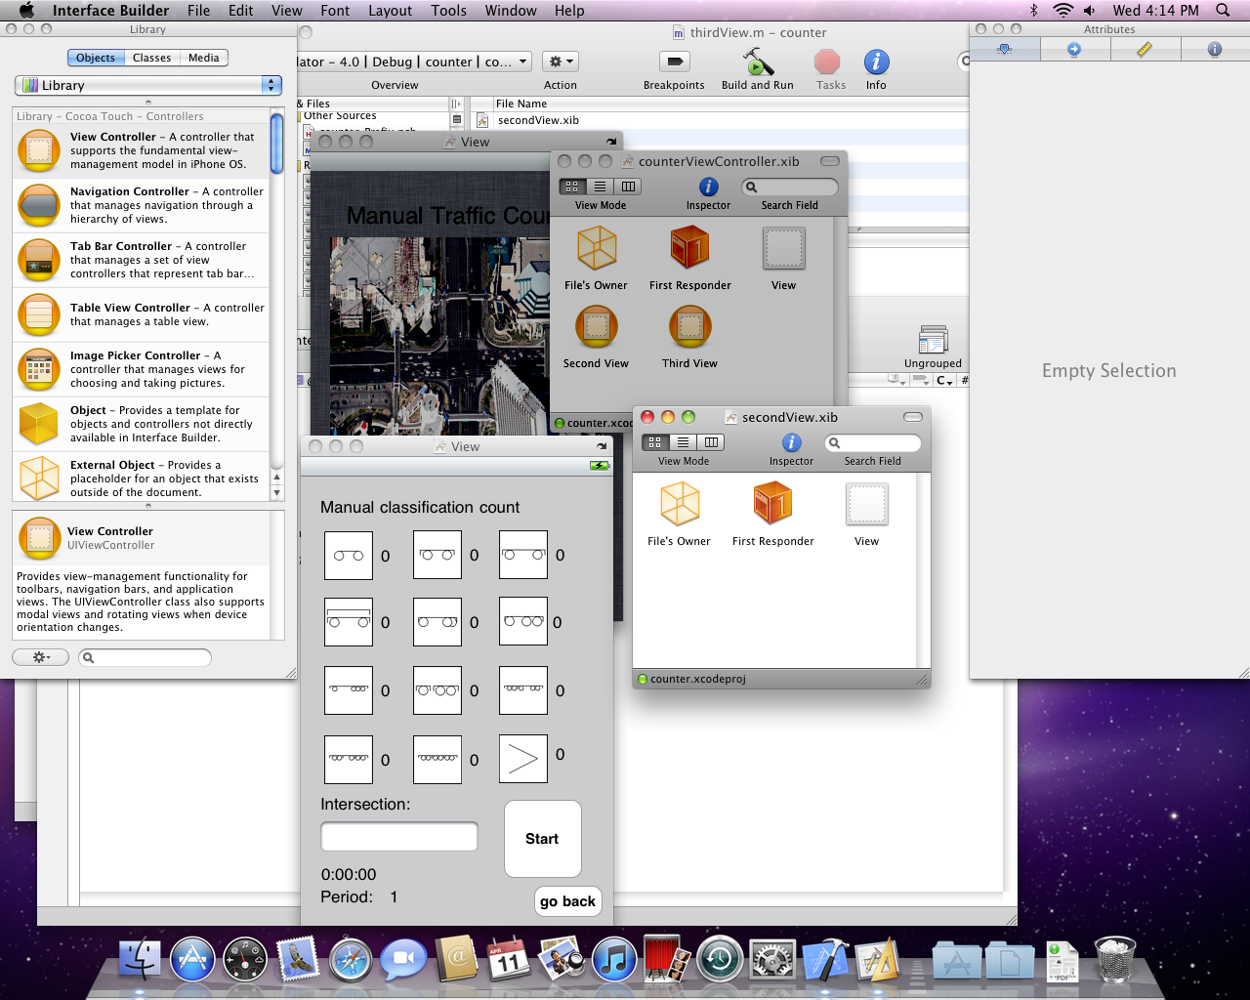
Traffic Counter Mobile Application
Victor Molano. E-mail: molanopa@nevada.unlv.edu
University of Nevada, Las Vegas
INTRODUCTION
OBJECTIVE
RESULTS
For all cases the screen will be on hold until the user code the number of periods and the total time for the data collection. once the user press the start button the application will start collecting data
Manual Counters:
The vehicles counts and characteristics at signalized intersections and others transportation facilities are usually made using manual counters. These manual counters are mechanical or digital boards in which the user can record the different observations from the field. The use of these devices is usually required when more sophisticated methods are not available, when expensive equipment is not justified and for scholastic practices.
The objective of the application is to use all the mobile devise capabilities such as the display, memory, touch screen, wireless access to internet, GPS and others.
The application contains 3 different functions as mentioned below. All of them can save the time period, location, and the time at which the measurement was done.
The application should be able to give the user the different required input methods such as buttons, and ways to collect data depending on the study or design in progress.
CONCLUSIONS
The initial screen contains the name of the application, name, and links to the functions.
The targets and objectives of the Counter application were achieved
Three different functions have been developed for this application and more functions can be coded
The portability, screen and storage capacity of this mobile device is appropriate to use on field
A tool to store and process these data can be implemented. After implementation, the collected data and GPS records can be sent wireless to a server or as other pre specified services such as e-mail
CHARACTERISTICS
The devise has buttons as input hardware, each with its own label and function.
When a different procedure is required a sheet is located over the device.
It has a small screen where the information about the data is displayed
Memory disk where the data is stored.
The most recent devices can record information using GPS.
To download the information from the device it is often necessary to have a wired connection directly to a computer.
REFERENCES
Beginning iPhone Development: Exploring the iPhone SDK, Jeff LaMarche
Introduction to Traffic Engineering: A Manual for Data Collection and Analysis, Thomas R Currin
Turning movement counts:
Left and right turns at each approach
Vehicle classification:
The classification of 12 different vehicles can be done
Pedestrian counts:
The type, approach and number of pedestrians can be recorded
CONTACT
Victor Molano
Phone:702 624 6499
University of Nevada, Las Vegas
molanopa@unlv.nevada.edu
victor.hugo.molano@gmail.com

